Slide 1
CECS 478: End-to-end Chat
By Team MIDI: Miguel Castorena & Diego Garcia

Slide 2
Overview
End-to-end chat application was written in Python
Libraries used:
OS - Used to generate pseudorandom data for key generation
Base64 - Used to convert ASCII strings to bytes, and also bytes to ASCII strings.
Cryptography - Used for AES and RSA encryption and decryption and HMAC tag generation and verification.
Requests - Used to send POST, GET, and PUT requests to the server from the client application.
RSA public and private keys generated using OpenSSL

Slide 3
Classes
Encryptor
Encryptor(keySize, blockSize, ivSize, publicCertificate)- Constructor, takes keySize, blockSize, and ivSize as integer inputs. (32 bytes, 128 bits, 16 bytes)
encrypt(msg) - Takes a string as an input message and calls AESEncrypt(), HMAC(), then RSAEncrypt(). Returns a dictionary containing cipher message, HMAC digest, and RSA encrypted AES and HMAC keys.
AESEncrypt() - uses message from encrypt() to perform AES encryption in CBC mode. Prepends IV to message, pads message using PKCS7, and encrypts.
HMAC() - uses cipher message from AESEncrypt() to generate and return an HMAC digest. HMAC key generated using os.urandom(keySize)
RSAEncrypt() - concatenates AES and HMAC keys and performs RSA encryption using the provided public key file. Returns cipher keys.

Slide 4
Classes
Decryptor
Decryptor(keySize, blockSize, ivSize, privateCertificate) - Constructor, takes keySize, blockSize, and ivSize as integer inputs. (32 bytes, 128 bits, 16 bytes)
decrypt(message) - Takes a dictionary as input containing the following keys and values: HMAC (digest), Msg (encrypted message), Keys (encrypted keys). Performs RSA decryption on the keys, HMAC verification, and AES decryption on the message contents. Returns the decrypted cipher message as a string.
RSADecrypt() - Uses provided private key file to decrypt the AES and HMAC keys. Stores the keys inside of the decryptor object for further use.
HMACVerify() - uses the cipher message and HMAC key to verify message integrity. Prints a success message if correctly verified and throws an error otherwise.
AESDecrypt() - Slices IV and message from cipher message and performs AESDecrypt using the decrypted AES key. Returns the decrypted message as a string.

Slide 5
Classes
Client
Client(URL) - Constructor, takes URL as a string input. URL is the login URL for our server.
login(email, password) - Takes an email and password as string inputs. Send a POST request to the server to authenticate. If login succeeds, success message is displayed and authentication token is stored, if not ValueError is raised
postMsg( URL, recipient, msg) - Takes a chat URL, recipient email, and message as string inputs. Sends a POST request to the server to create the message in the database. If message send fails, a ValueError is raised.
getMsg(URL) - Takes a chat URL as string input. Sends a GET request to fetch messages from database for the user using their JWT authentication token stored from login().
register(email, password) - Takes an email and password as a string input. Sends a POST request to the server to register the new user. Prints a success message if registered, throws an error message if registration fails.

Slide 6
Key Exchange
Current key exchange method is simply email.
Users will generate their own public and private keys via OpenSSL and email each other their public keys.
Future work on this chat client may implement Ephemeral Diffie-Hellman Key Exchange using cryptography.io’s built in key generation and Ephemeral Diffie-Hellman Key Exchange methods.
This will require the writing of new routes on our server’s RESTful API to facilitate and exchange handshake data.

Slide 7
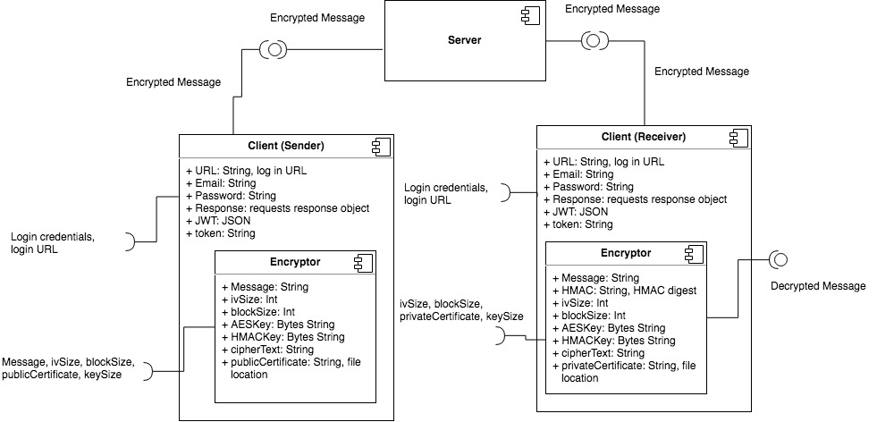
System Component Diagram

Slide 8
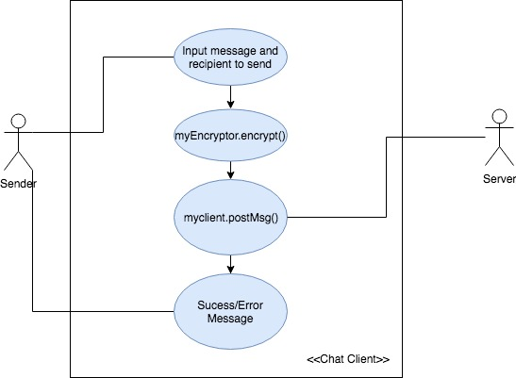
Use Case Diagram: Send Message

Slide 9
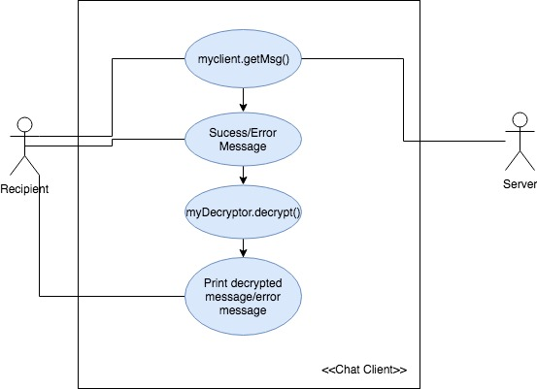
Use Case Diagram: Receive Message

Slide 10

Sample invocation: Register a new user

Slide 11
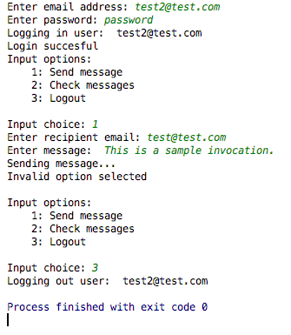
Sample invocation: Login and send message

Slide 12
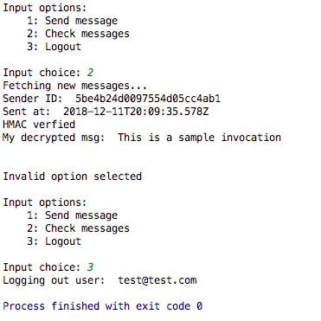
Sample invocation: Receive message

Slide 13
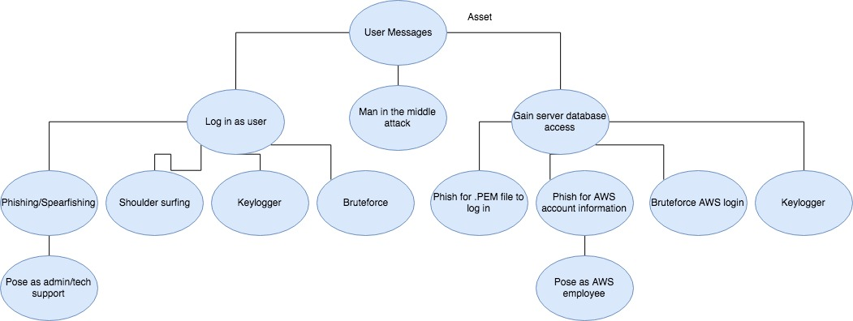
Attack Surface Tree: User Messages

Slide 14
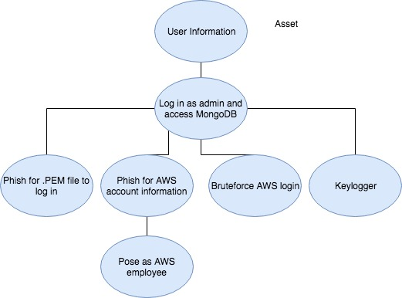
Attack Surface Tree: User Information

Slide 15

Questions?

